Slide 1
Heart Disease Prediction❤️📊🖥️
Machine Learning Project
Calvin Kleber
Prachi Shingvi
Pratik Deshmane
Mike Strati
Eric Huynh
Shridhik John
Notes:
Hey guys, I’m John, and in our group we’ve got Calvin, Prachi, Pratik, Mike, and Eric.
For our MAchine LEarning Project We’ll be going over HEart Disease PRediction

Slide 2
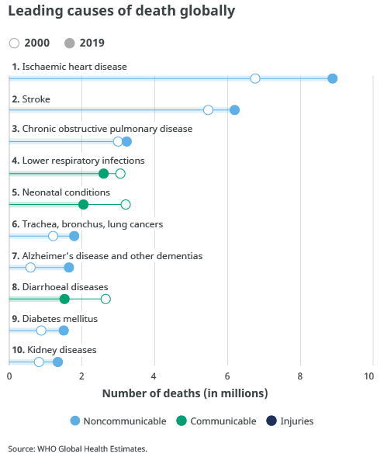
"Cardiovascular diseases are the leading cause of death worldwide, accounting for an estimated 17.9 million lives each year."
-World Health Organization
Figure 2.1 This chart shows the top global causes of death in 2019, with ischaemic heart disease, stroke, and chronic respiratory conditions leading.
Notes:
Cardiovascular Disease is an umbrella term for a multifactorial group of diseases affecting the structure and function of the heart.
Why did we choose to look into heart disease? Well its the leading cause of death globally, claiming an estimated 18 million lives each year, accounting for more than 1 in 4 Deaths.
The point of our project is to focus on Early detection as that can significantly improve treatment outcomes with the potential to prevent severe complications like heart attacks or strokes.

Slide 3
Importance
Our Predictive Tool: An Overview
We will be going over the machine learning models we used to build an app for doctors analyzing multiple risk factors (age, cholesterol levels, blood pressure, etc.) to predict heart disease risk.
Benefits for Doctors
Enhanced Decision Making
Assists doctors in making informed decisions by providing an additional layer of analysis.
Time Efficiency
Streamlines the initial assessment process, allowing doctors to focus on critical cases.
Patient Engagement
Facilitates discussions with patients about their health risks and preventive measures.
Notes:
So upon testing and leveraging machine learning models learned in class, our group worked on building an app built catered towards doctors, examining features that only they would have the tools and access to.
A tool like this will not only help a doctor make smarter decisions faster, it will also allow them to know what features a patient should spend more time focusing on improving.

Slide 4
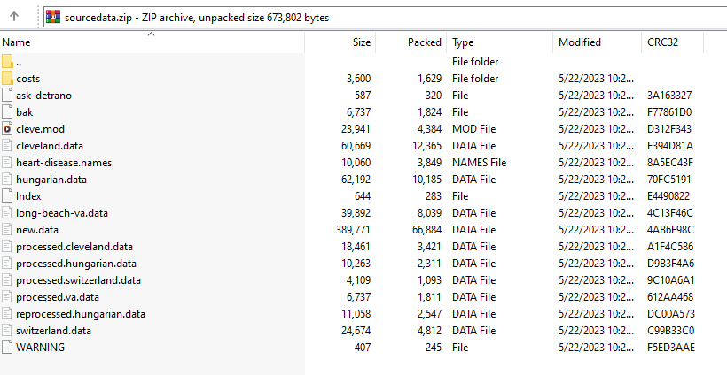


Source of the Dataset
https://www.kaggle.com/datasets/fedesoriano/heart-failure-prediction
UC Irvine Machine Learning Repository
Janosi,Andras, Steinbrunn,William, Pfisterer,Matthias, and Detrano,Robert. (1988). Heart Disease. UCI Machine Learning Repository. https://doi.org/10.24432/C52P4X.
Figure 4.2 Zip file folder of the source dataset from UC Irvine Machine Learning Repository
Notes:
Initial Source was from Kaggle with a total of 900 rows of data with about 12 attributes. We dove a bit deeper into where they got their data source and learned more about where the data came from and traced it to UC Irvine Machine Learning Repository. I found out the dataset was donated to the repository and came from four different locations:
Cleveland Clinic Foundation (Cleveland): This is the primary source that has been widely used by machine learning researchers. The data collected here is often the focus of experiments and analysis.
Hungarian Institute of Cardiology (Hungary): Data from this institution is also included in the dataset.
V.A. Medical Center, Long Beach, CA (VA Long Beach): This institution contributed to the dataset.
University Hospital, Zurich, Switzerland (Switzerland): Data from this Swiss institution is part of the dataset as well.
After diving into the source I found more information on the documentations, raw datasource, and learned about the data preprocessing steps

Slide 5
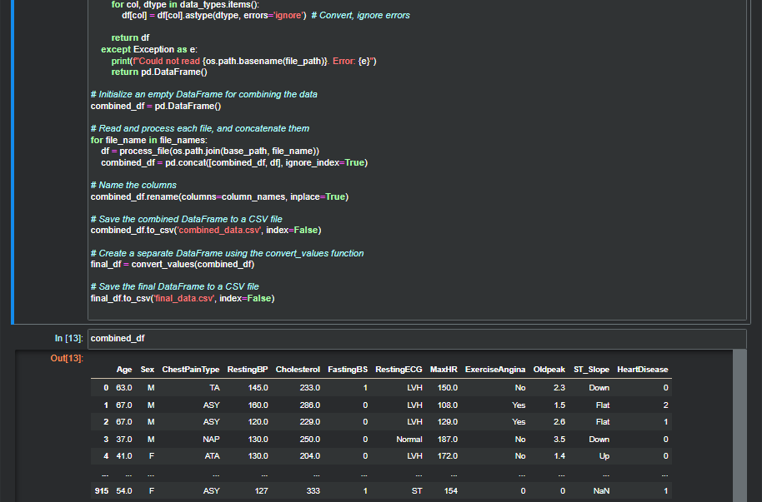
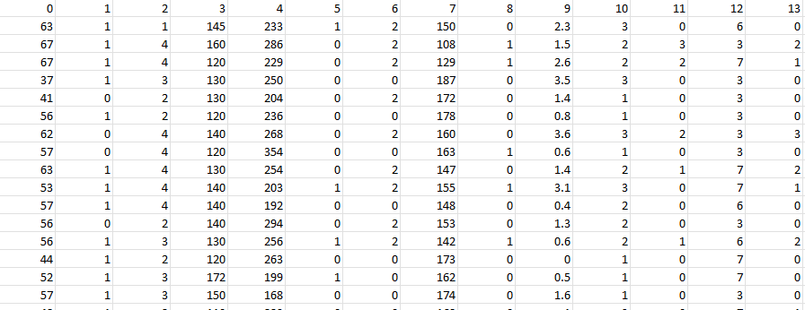
Dataset Preprocessing
Python Pandas
Consistency in Column Names
Data Type Conversions
Merge Datasets
Column Deletion
Decoding Categories
One Hot Encoding
Figure 5.2 Zip file folder of the source dataset from UC Irvine Machine Learning Repository
Figure 5.1 Snippet of the python preprocessing code
Figure 5.3 Raw heart disease dataset

Slide 6
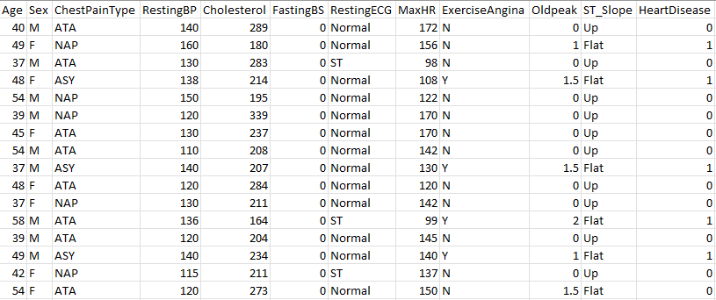
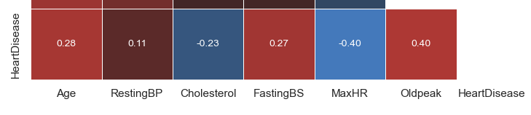
Features of the Dataset
Age The age of the patient.
Sex The gender of the patient (M for male, F for female).
ChestPainType Type of chest pain experienced by the patient (ATA, NAP, ASY, TA).
RestingBP Resting blood pressure (in mmHg).
Cholesterol Serum cholesterol (in mg/dl).
FastingBS Fasting blood sugar (> 120 mg/dl is coded as '1').
RestingECG Resting electrocardiogram results. (LVH, Normal, ST)
MaxHr Maximum heart rate achieved.
ExerciseAngina Angina induced by exercise (Y = Yes, N = No).
Oldpeak ST depression induced by exercise relative to rest.
ST_Slope The slope of the peak exercise ST segment. (Up, Flat, Down)
HeartDisease Indicates the presence of heart disease (1 = Yes, 0 = No).
Figure 6.1 Heart Disease Dataset in viewed in Excel (Dataset contains 918 rows, each representing a patient).
Figure 6.2
Notes:
Here are the variables that we are interested in that would help use detect whether or not the patient has a heart disesase. The most important thing to mention about the dataset is that these are usually tests for noninvasive test therefore the application of this app should be easily accessible with common metrics you would get from lab tests or cardio tests such as an ECG.

Slide 7
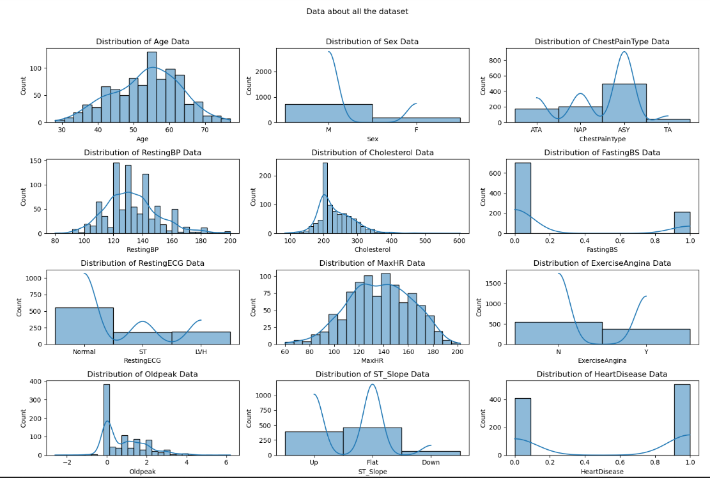
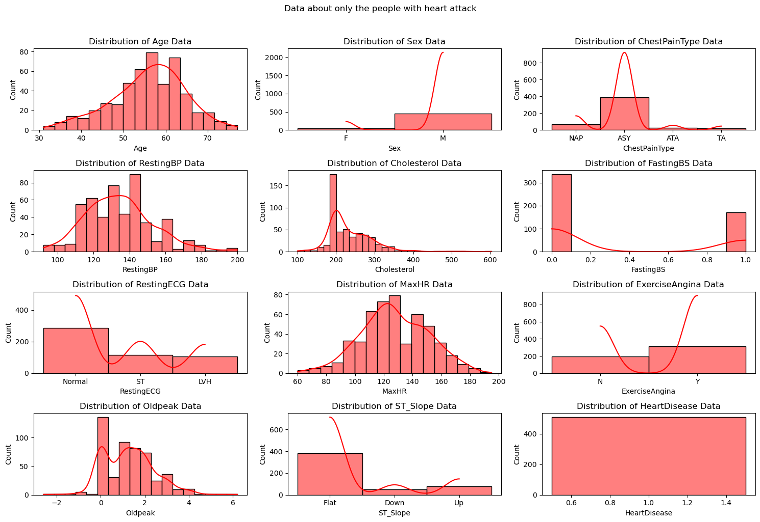
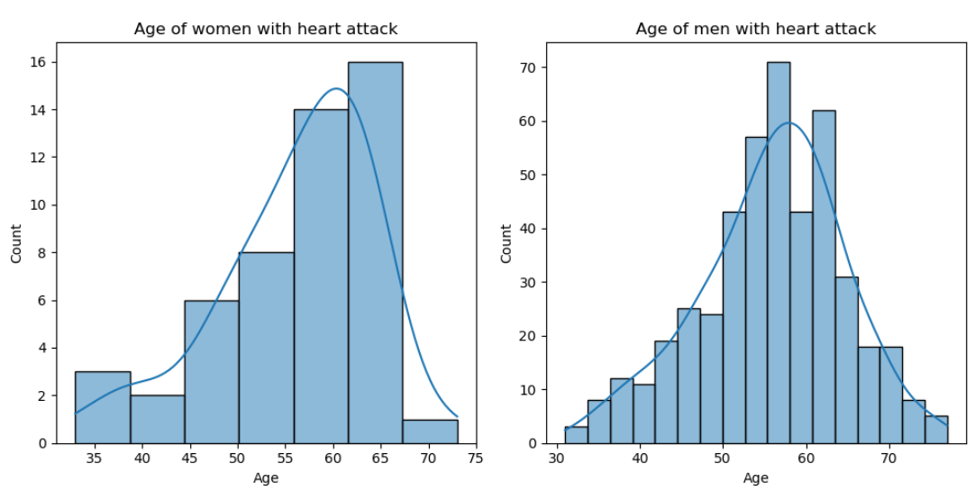
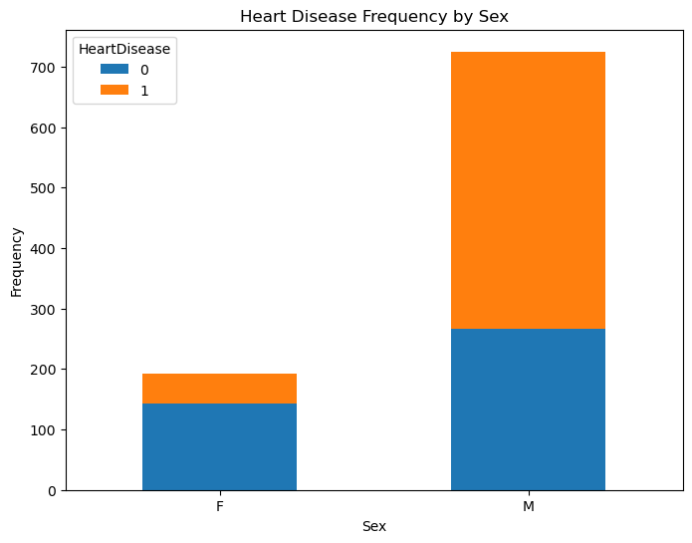
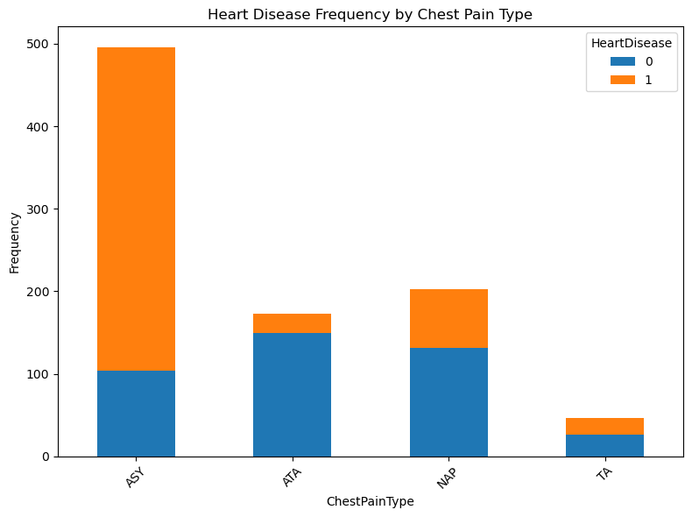
Visualizations
Notes:
First we did Data cleaning to find any missing values in our data set.
Second we did Exploratory Data Analysis(EDA) which typically includes Univariate And Multivariate Analysis.
Univariate Analysis:-
Age: The distribution is fairly normal but slightly skewed towards older ages. This suggests a larger proportion of middle-aged and elderly individuals in the dataset.
RestingBP: The distribution is approximately normal, with a concentration of values around the 120-140 range, which is typical for resting blood pressure.
Cholesterol: We observe a peak around 200-300 mg/dL, which is common for cholesterol levels, but there are significant cases of very low cholesterol (near 0) which might be outliers or data entry errors.
FastingBS: This binary variable shows a majority of values at 0, indicating that most individuals did not have fasting blood sugar above 120 mg/dl.
MaxHR: The distribution is fairly normal with a slight left skew, indicating a range of maximum heart rates during exercise.
Oldpeak: The distribution is skewed right, with most values clustered near 0, suggesting many individuals did not have a significant ST depression.
Heart Disease: This binary variable is fairly balanced, with a slight majority of cases indicating the presence of heart disease.
Sex: There are significantly more male participants than female participants in the dataset.
ChestPainType: The most common type of chest pain in the dataset is 'ASY' (Asymptomatic), followed by 'NAP' (Non-Anginal Pain), 'ATA' (Atypical Angina), and a few instances of 'TA' (Typical Angina).
RestingECG: The majority of participants have a 'Normal' resting electrocardiogram, followed by 'ST' and a smaller number of 'LVH' (Left Ventricular Hypertrophy) cases.
ExerciseAngina: More participants do not experience angina induced by exercise ('N') compared to those who do ('Y').
ST_Slope: The most common ST slope observed is 'Flat', followed by 'Up' and a smaller number of 'Down'.

Slide 8
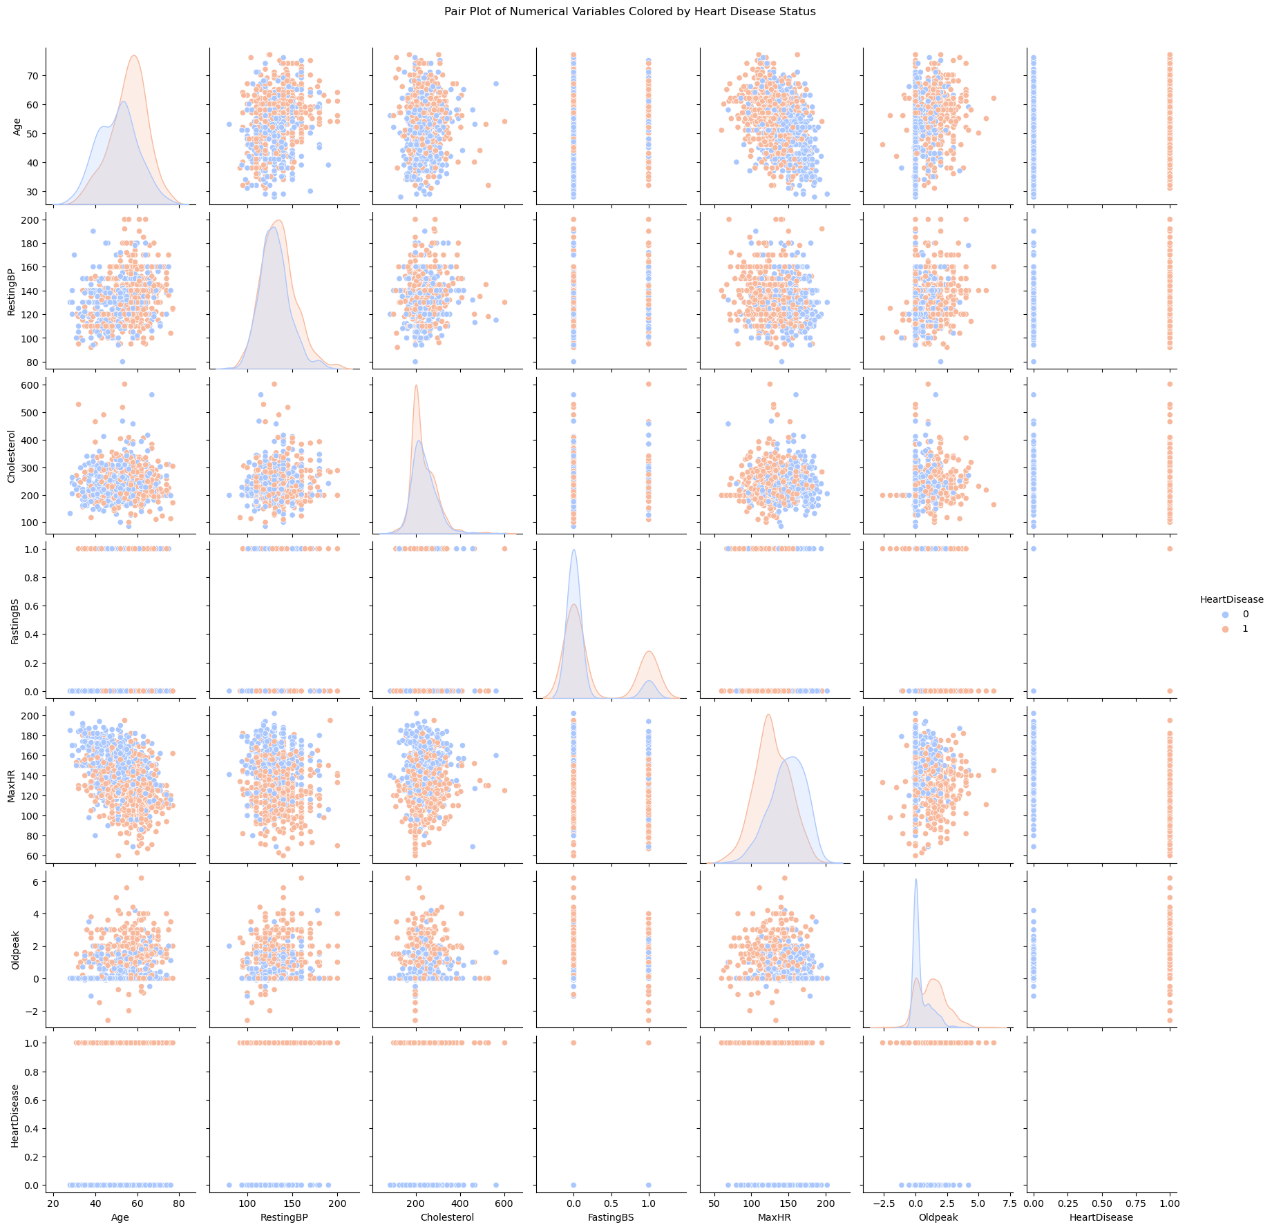
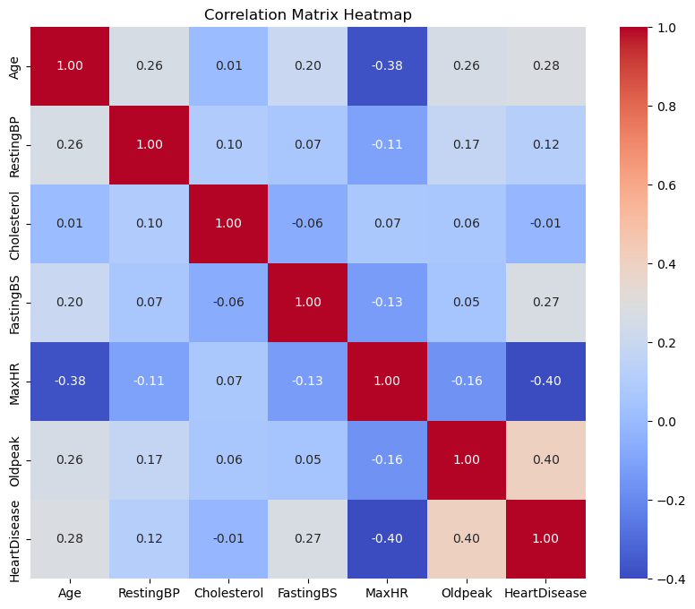
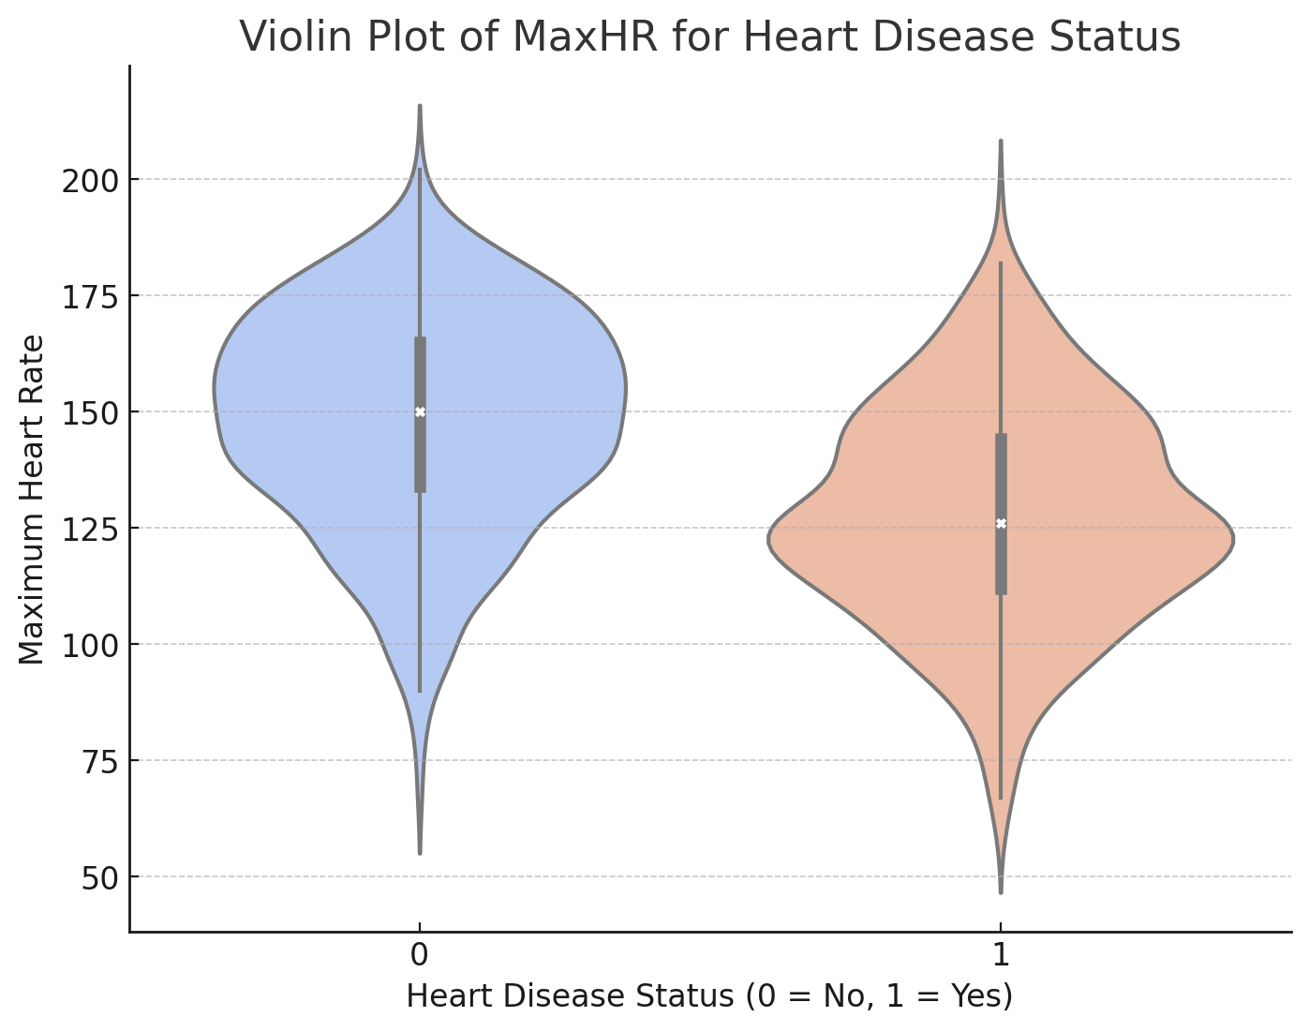
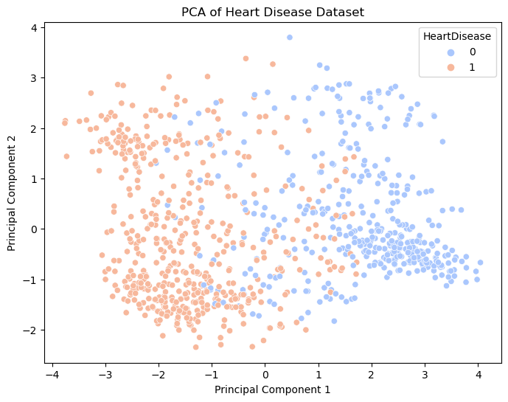
Visualizations
Notes:
4) Correlation Analysis for Numerical Variables
Age and HeartDisease: There is a moderate positive correlation (around 0.28), suggesting that older age is somewhat associated with a higher likelihood of heart disease.
RestingBP and Age: A small positive correlation (around 0.25), indicating that blood pressure tends to be higher with increasing age.
MaxHR and Age: A negative correlation (around -0.38), showing that maximum heart rate during exercise tends to decrease as age increases.
Cholesterol and Age: Interestingly, there is a very low correlation, indicating that cholesterol levels do not significantly change with age in this dataset.
Oldpeak and HeartDisease: There is a moderate positive correlation (around 0.40), suggesting that higher ST depression (measured by the Oldpeak) is associated with a higher likelihood of heart disease.
FastingBS and HeartDisease: A moderate correlation (around 0.26) indicating a relationship between fasting blood sugar levels and heart disease.
5) Pair Plot to check the presence of Heart disease for each pair of numerical Variables in DS. The pair plot allowed us to quickly identify patterns or correlations between variables. For example, we could see if there was a positive, negative, or no clear relationship between each pair of variables.
In the scatter plot of Age vs. MaxHR, we might have observed a trend where older individuals (higher Age) generally had lower maximum heart rates (MaxHR). Additionally, the concentration of heart disease cases (possibly in a distinct color) in certain areas of this plot could indicate a higher prevalence of heart disease among older individuals with lower maximum heart rates.
6) Violin Plot-
We observe that the distribution of MaxHR for individuals without heart disease (0) is more spread out, indicating a wider range of heart rates in this group.
For individuals with heart disease (1), the violin plot is narrower, particularly in the higher heart rate range. This suggests that individuals with heart disease tend to have lower maximum heart rates.
The median MaxHR appears to be lower for individuals with heart disease compared to those without.
7) Principal Component Analysis(PCA):
In a presentation, you can emphasize how PCA helped in visualizing the high-dimensional heart disease dataset in a more manageable two-dimensional space, revealing potential patterns and groupings related to heart disease. This method is particularly valuable for identifying underlying structures in the data, which can be crucial for further analysis or predictive modeling.

Slide 9
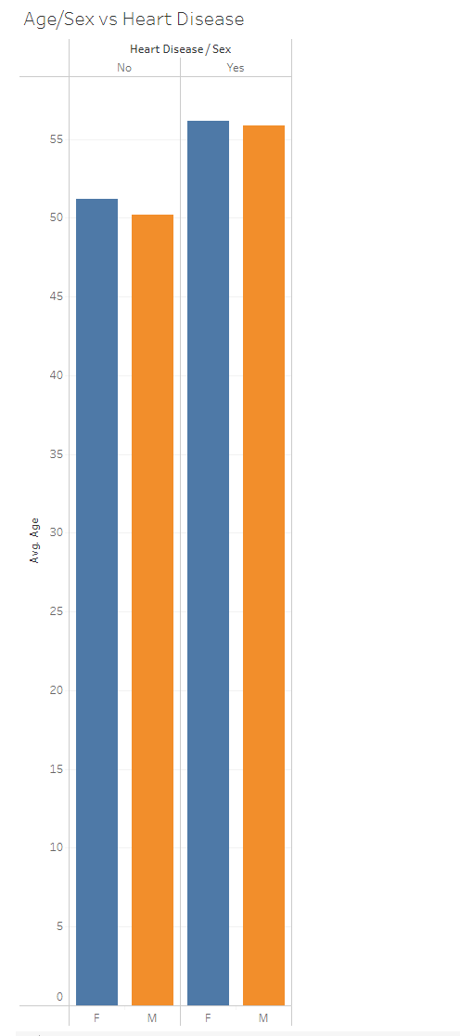
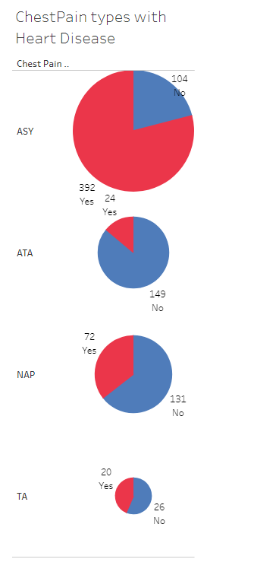
A Tableau Point of View
Used Tableau to recognize early patterns and make initial predictions regarding heart disease.
Older Males tend to be more at risk for Heart Disease.
Among the Chest Pain types, patients with Asymptomatic symptoms have the most Heart Diseases.
Notes:
Calvin

Slide 10
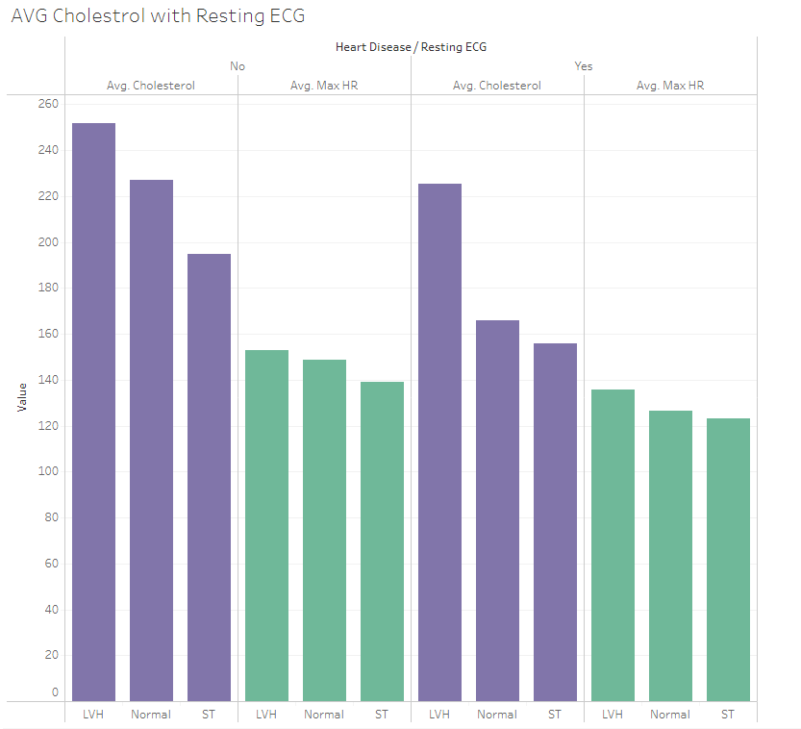
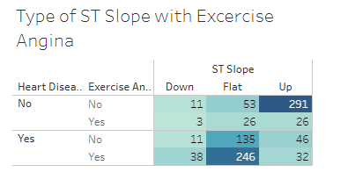
A Tableau Point of View
-Looked into the different types of ST Slopes with Exercise Angina
-Dove into AVG HR and AVG Cholesterol and it correlation with Resting ECG.
Notes:
Calvin
ST= irregular LVH = left ventricular hypertrophy
Excervise Angina= induced exercise pain

Slide 11
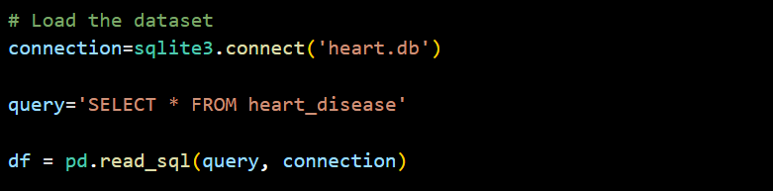
Data Storage/Retrieval
Given our dataset was in csv format we used Pandas to read the data
We used sqlite3 to create connection and store our data in SQL database
Additionally this SQL database was used as data source for training our model
Notes:
Prachi

Slide 12
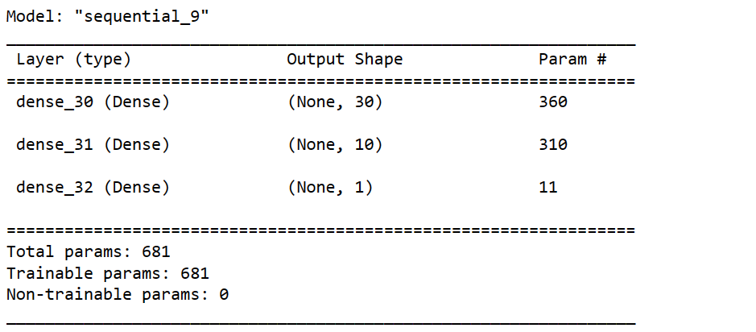
Attempt 1 : Neural Network
Created neural network with 2 hidden layers using ReLu as activation function
Used ‘sigmoid’ as activation function for output layer
To train the model we have used the adam optimizer and trained with 100 epochs
Notes:
Prachi

Slide 13
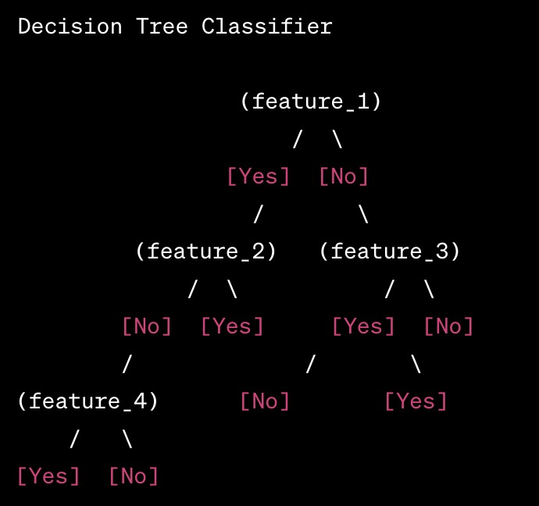
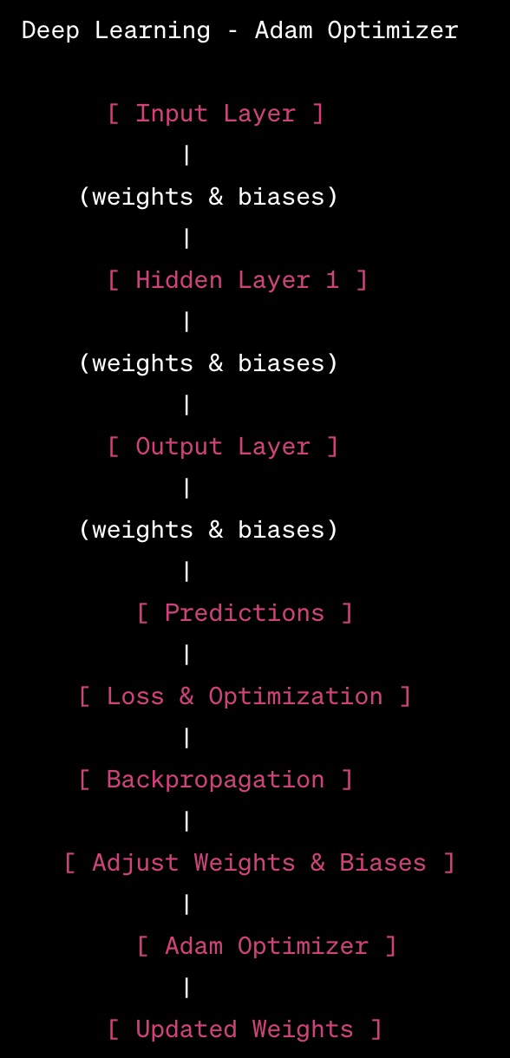
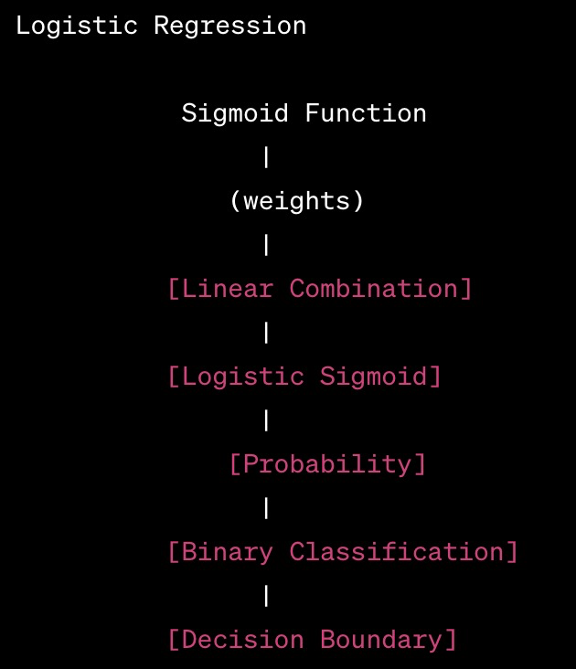
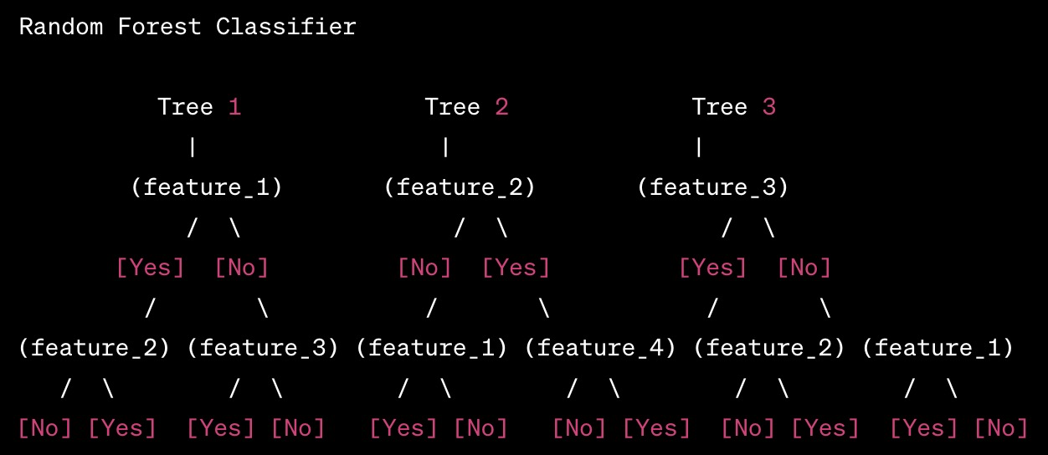
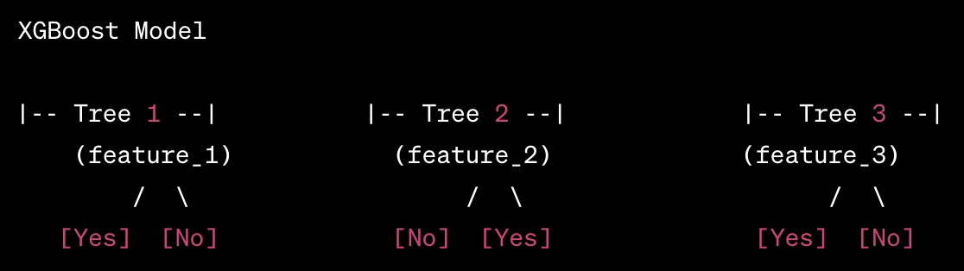
5 Models Tested
Decision Tree Classifier (Tree-Based Model - Classification)
Random Forest Classifier (Ensemble Learning - Classification)
Logistic Regression
(Linear Model - Classification)
Deep Learning - Adam Optimizer
(Neural Network - Supervised Learning)
XGBoost (Extreme Gradient Boosting - Ensemble Learning - Classification)
Notes:
SPEAKER // MIKE //
Thank you Prachi. As Prachi said, For this Project we decided to try out 5 Models:
> A Tree-Based Model: Decision Tree Classifier ( top right )
> 2 Ensemble models: Random Forest and XGBoost
> A Linear Model: Logistic Regression ( center of your screen )
> and the Adam Optimizer - Neural Network that Prachi described
[ Next Slide ]
---------------------------take text from below----------------------------- XX. **Decision Tree Classifier (Tree-Based Model - Classification):**
- Decision Tree Classifier is a tree-based model that recursively splits the dataset into subsets based on the most significant attribute, forming a tree structure. It is a transparent model, easy to interpret, making decisions based on feature values at each node.
- **Preferred Dataset Format:** (d) no Data Encoding Necessary
XX. **Random Forest Classifier (Ensemble Learning - Classification):**
- A Random Forest Classifier is an ensemble model that builds multiple decision trees during training and outputs the mode of the classes for classification problems. It enhances performance and robustness by combining the predictions of multiple decision trees.
- **Preferred Dataset Format:** (a) One-Hot-Integer
XX. **XGBoost (Extreme Gradient Boosting - Ensemble Learning - Classification):**
- XGBoost is a powerful ensemble model that employs a gradient boosting framework, building trees sequentially to correct errors of the preceding ones. It is known for its speed and performance optimization, making it a popular choice in various machine learning competitions.
- **Preferred Dataset Format:** (a) One-Hot-Integer
XX. **Logistic Regression (Linear Model - Classification):**
- Logistic Regression is a linear model used for binary classification. Despite its name, it is a regression model adapted for classification by applying the logistic sigmoid function, providing probabilities that an instance belongs to a particular class.
- **Preferred Dataset Format:** (c) Standard Scaler
XX. **Deep Learning - Adam Optimizer (Neural Network - Supervised Learning):**
- Deep Learning refers to neural networks with multiple layers. The Adam Optimizer is an optimization algorithm often used with deep learning models, adjusting the learning rates of each parameter individually to improve convergence speed and overall performance during training.
- **Preferred Dataset Format:** (b) MinMax Scaler

Slide 14
Optimal DataSet Formats
Decision Tree - no encoding necessary
Random Forest - One-Hot Integer
LogReg - Standard Scaler
Deep-Adam - MinMax Scaler
XGBoost - MinMax Scaler
Notes:
SPEAKER // MIKE //
We chose these 5 Models with the purpose of running 3 separate encodings of our DataSet through:
1 - One-Hot-Encoded Integer with No Scaling ,
2 - Standard Scaler,
3 - and MinMax Scaler
Based on our research, each Model had its own recommended DataSet format that you can see listed below the Model.
Worth calling out is Decision Tree recommended No Encoding, it can handle categorical variables directly in its raw form.
So good lesson learned: Scaling was only necessary depending on the Model. But a good beginner experiment to run regardless.
[ NEXT SLIDE ]
2 for MinMax Scaler, 1 Integer, 1 Standard, and

Slide 15
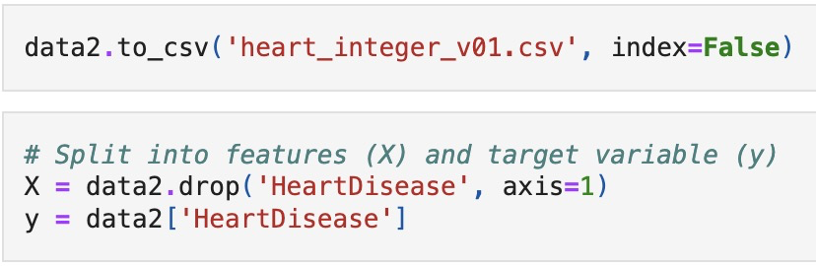
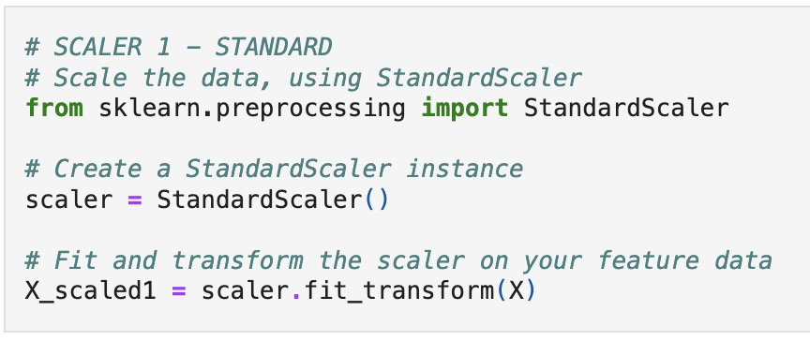
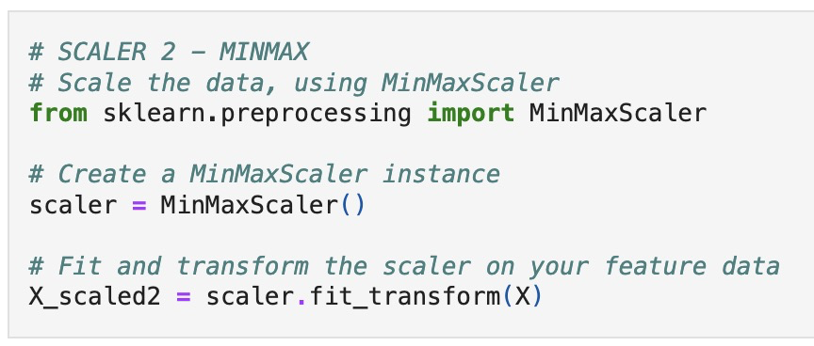
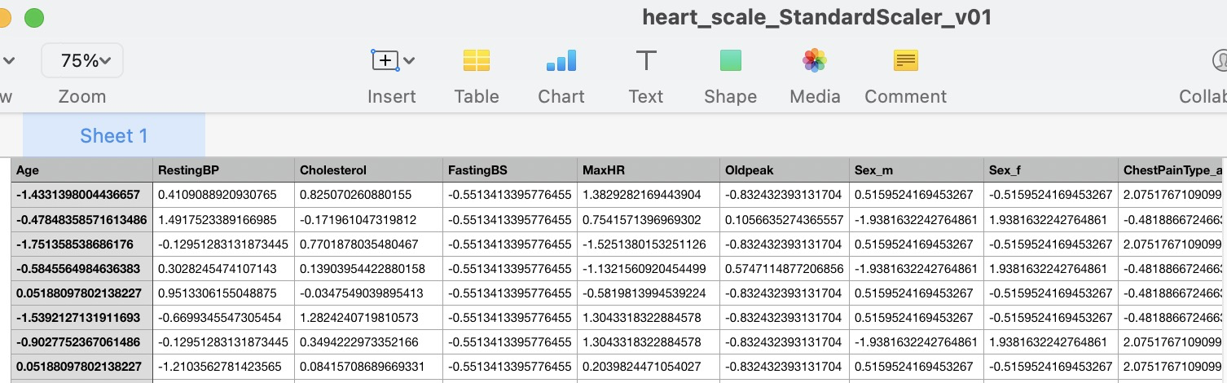
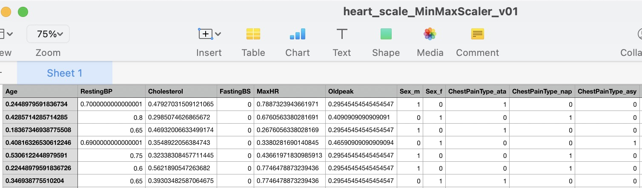
Split FEATURES(X) and TARGET VARIABLE(y), before SCALING
STANDARD
MINMAX
Notes:
SPEAKER // MIKE // Next up is Scaling Process. We made sure to split the dataset into FEATURES (X) and the TARGET VARIABLE (y) BEFORE scaling to maintain the integrity of the scaled-dataset during the scaling process.
[ Next Slide ]
Again, our goal was to feed INTEGER, STANDARD SCALER, and MINMAX SCALER through all 5 Models.
We then used both STANDARD SCALER and MINMAX SCALER to be able to test both types of Scaled Datasets in our 5 Models, mostly out of curiosity.

Slide 16
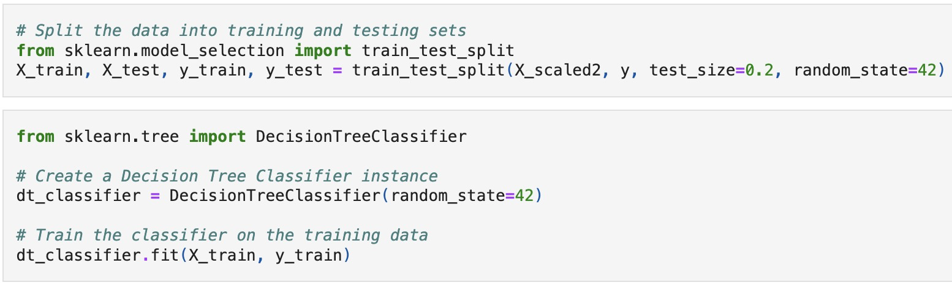
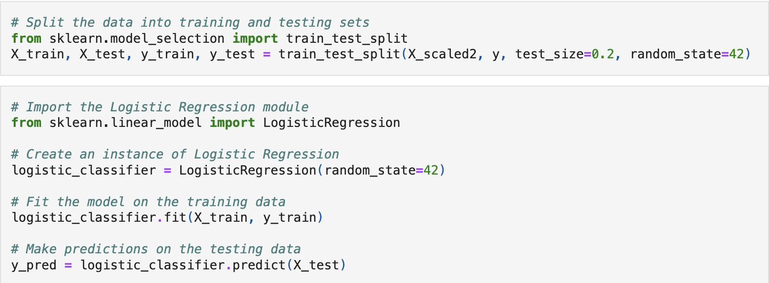
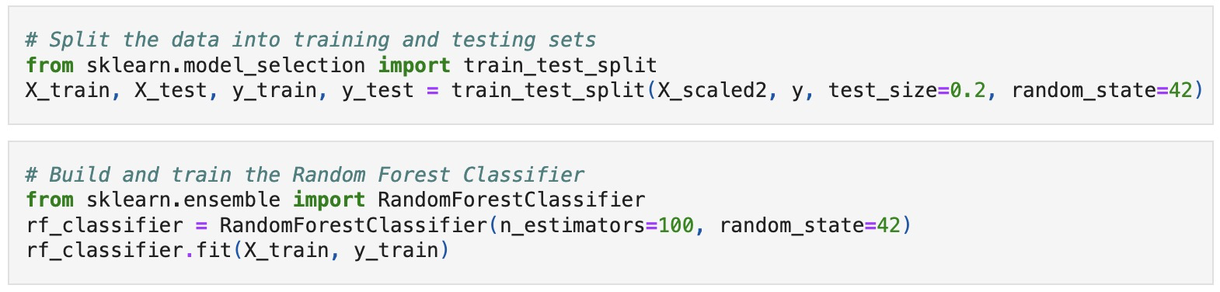
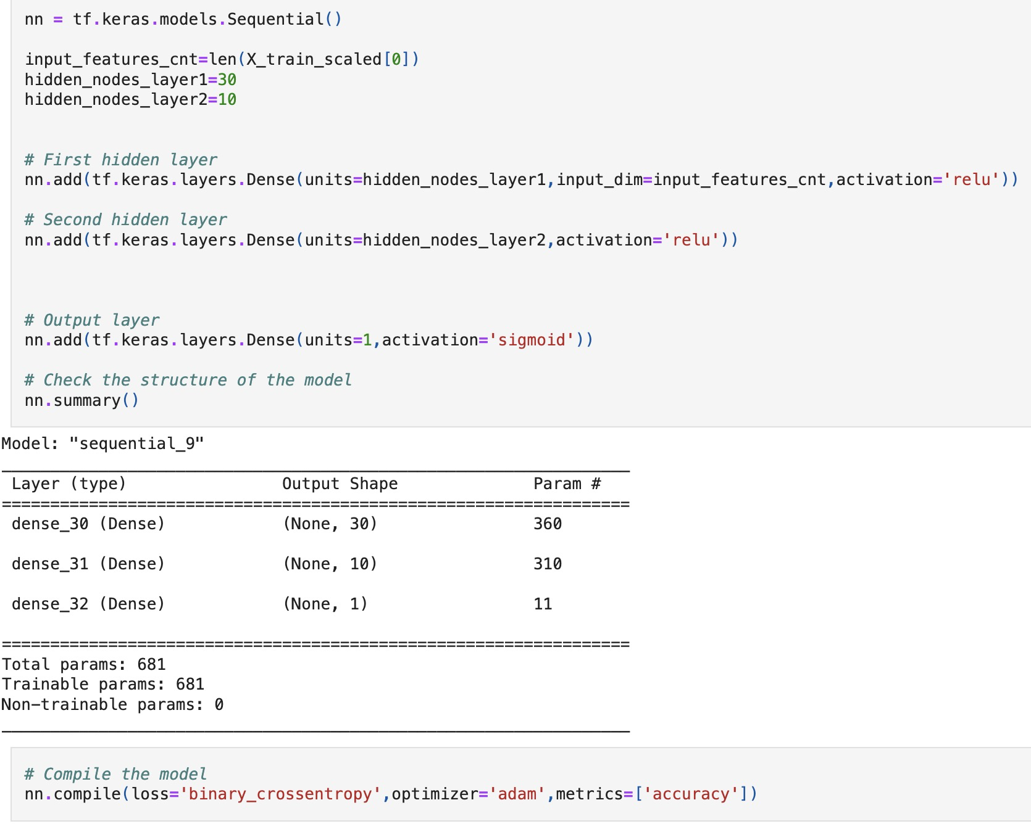
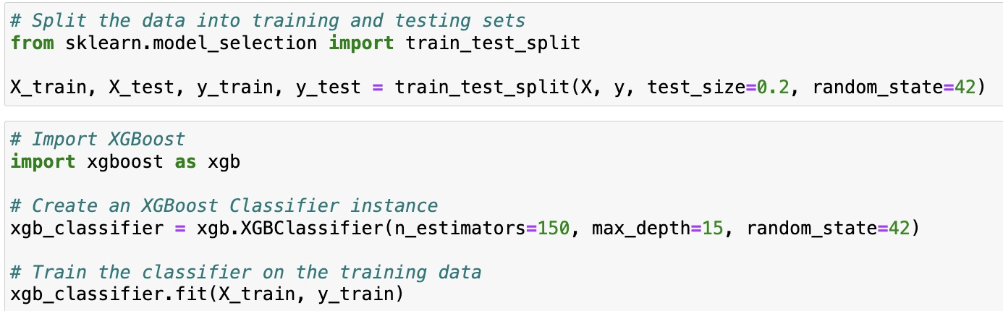
General Parameters for each of the 5 Models
PARAMETERS // Decision Tree
PARAMETERS // Logistic Regression
PARAMETERS // Random Forest
PARAMETERS // Deep Learning
PARAMETERS // XGBoost
Notes:
SPEAKER // MIKE //
As far as PARAMETERS for our test runs. PRACHI spoke to the PARAMETERS for the DEEP LEARNING MODEL. TEST SIZE parameter = we kept at 20%.
At the time that we tested XGBoost Model--which was last--we had already seen optimization success based on Andrew’s Suggestion with
increasing both N_ESTIMATORS as well as adding MAX_DEPTH in our RANDOM FOREST MODEL…we added those parameters to XGBoost.
> N_ESTIMATORS = being the NUMBER OF DECISION TREES
> MAX_DEPTH = being the MAXIMUM NUMBER COUNT allowed for any TREE GROUP in the random forest
[ Next Slide ]
///////////////////////////////////////////////////////////////////////////////////////////////////////////////////////////////////////////////////
Neural Network Architecture in Deep Learning: // The deep learning model consists of two hidden layers with 30 and 10 nodes, emphasizing a moderate-sized neural network. This balance aims to capture hierarchical features without excessive complexity. The deep learning model employs the Adam optimizer, known for adaptive learning rates. This helps the model converge efficiently by adjusting learning rates based on the historical gradients.
We also eventually added MAX_DEPTH of 15 to the original DECISION TREE model at the top to test, but didn’t see a change in ACCURACY in that scenario.

Slide 17
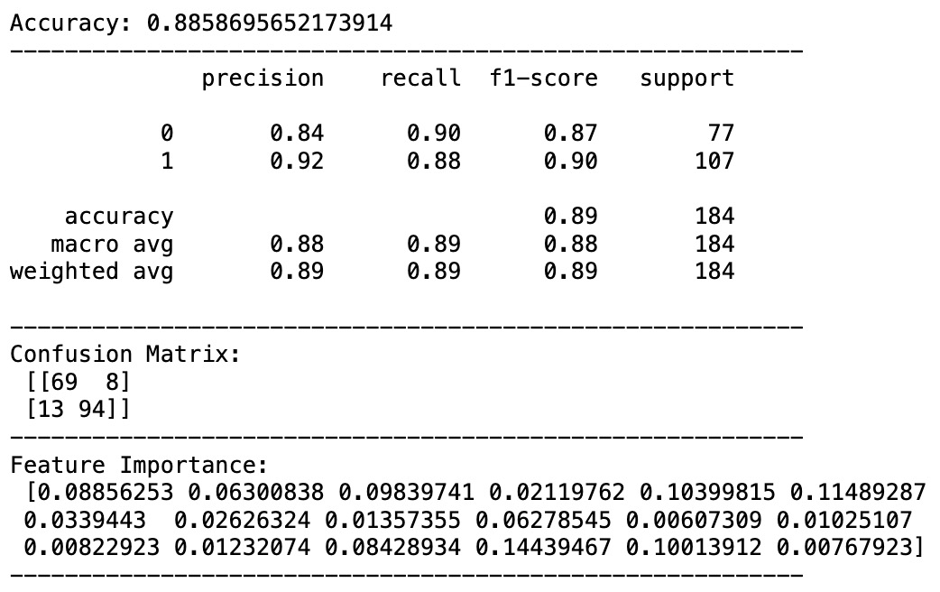
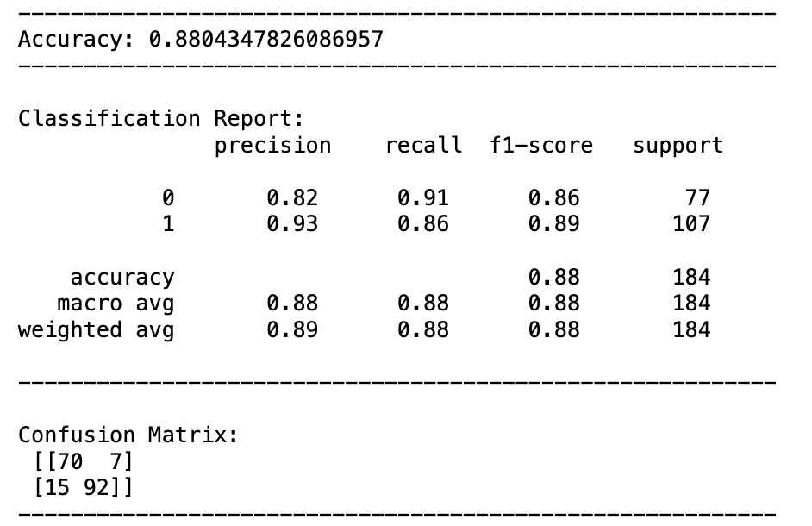
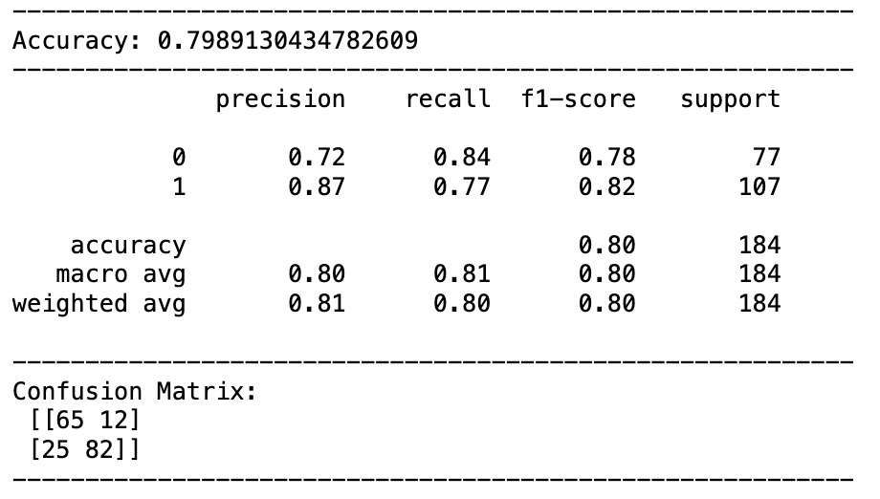
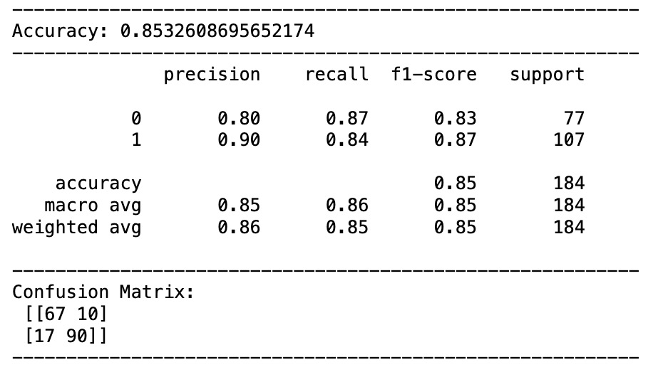
Accuracy Score, Classification Report, Confusion Matrix (Integer Dataset )
Random Forest
XGBoost
Decision Tree
Deep Learning
Logistic Regression
Notes:
SPEAKER // MIKE //
So running our models…Here we are looking at ACCURACY SCORE, CLASSIFICATION REPORT, and CONFUSION MATRIX, tested on our INTEGER DATASET.
A few items to highlight:
Random Forest and XGBoost demonstrate better performance compared to other models in terms of ACCURACY, PRECISION, and RECALL.
Both models achieve accuracy scores 88% or higher, indicating their robustness in predicting heart disease.
Logistic Regression exhibits reliable performance with an accuracy of 85.3%, only 1 point below Deep Learning...indicating a less complex linear model can still provide a reasonable level of accuracy.
Finally, worth calling out is The Decision Tree Classifier. While achieving a respectable accuracy of 79.8%, it demonstrates a trade-off between PRECISION and RECALL.
Decision Tree is 87% Accurate when predicting TRUE POSITIVES for Heart Disease, that’s the PRECISION.
But RECALL percentage at 77 is showing us that 23% of Class 1 - Heart Disease Calls were missed, meaning 23% FALSE NEGATIVES from the Decision Tree Classifier.
[ Next Slide please ]
Understanding this trade-off is important when considering the impact of false positives and false negatives on heart disease predictions.
As we’ll see in our next slide, DECISION TREE CLASSIFIER had the HIGHEST COUNT of FALSE POSITIVES and FALSE NEGATIVES.
Precision (for class 1 - heart disease): 0.87 // This means that among all instances predicted as positive (heart disease), 87% were correctly identified (True Positives), and 13% were false alarms (False Positives).
Recall (for class 1 - heart disease): 0.77 // This indicates that the model identified 77% of the actual instances of heart disease (True Positives), but 23% were missed (False Negatives).
>> 1. Random Forest and XGBoost Outperform Others: //
>> 5. Logistic Regression Reliability: //
>> 6. Decision Tree Classifier Trade-Offs: //

Slide 18
TABLE // Accuracy Scores & Confusion Matrix
Jupyter - MinMax Scaled Dataset | Jupyter - StandardScaler Scaled Dataset | Jupyter - One-Hot Integer Dataset
1 - Random Forest Classifier - 88.5 % | 1 - Random Forest Classifier - 88.5 % | 1 - Random Forest Classifier - 88.5 %
2 - XGBoost - 88.0 % | 2 - XGBoost - 88.0 % | 2 - XGBoost - 88.0 %
3 - Logistic Regression - 86.4 % | 3 - Deep Learning-Adam Optimizer - 86.5 % | 3 - Deep Learning-Adam Optimizer - 86.9 %
4 - Deep Learning-Adam Optimizer - 85.6 % | 4 - Logistic Regression - 85.3 % | 4 - Logistic Regression - 85.3 %
5 - Decision Tree Classifier - 78.8 % | 5 - Decision Tree Classifier - 78.2 % | 5 - Decision Tree Classifier - 79.8 %
 | CONFUSION | MATRIX (Integer DataSet)
True Positives: | True Negatives: | False Positives: | False Negatives:
2. Random Forest Classifier: 94 | 2. XGBoost: 70 | 1. Decision Tree Classifier: 12 | 1. Decision Tree Classifier: 25
3. XGBoost: 92 | 3. Random Forest Classifier: 69 | 2. Logistic Regression: 10 | 2. Logistic Regression: 17
4. Logistic Regression: 90 | 4. Logistic Regression: 67 | 4. Random Forest Classifier: 8 | 4. XGBoost: 15
5. Decision Tree Classifier: 82 | 5. Decision Tree Classifier: 65 | 5. XGBoost: 7 | 5. Random Forest Classifier: 13
…thus move forward with Optimizing:
RANDOM FOREST CLASSIFIER ==>
Notes:
SPEAKER // MIKE //
We continue to look at performance here.
Confusion Matrix. In the center In Red. You see DECISION TREE CLASSIFIER had the HIGHEST COUNT of FALSE POSITIVES and FALSE NEGATIVES.
Understanding this trade-off is important when considering the impact of FALSE NEGATIVES on heart disease predictions.
-----------------------
Again RANDOM FOREST coming in with the Highest Accuracy Score, with XG Boost at number 2. Both models were unaffected by the format of Dataset (RANDOM FOREST & XGBOOST).
It's worth noting here that RANDOM FOREST CLASSIFIER had the FEWEST FALSE NEGATIVES, making it the model with the HIGHEST RECALL (ability to capture TRUE POSITIVE cases). This information can be valuable for scenarios where minimizing the risk of missing actual heart disease cases is a priority.
Taking into account HIGHEST OVERALL ACCURACY SCORE combined with the LOWEST FALSE NEGATIVES, that gave us the confidence to move forward with RANDOM FOREST CLASSIFIER as the model we sought to optimize…
-----------------------
as it came to next OPTIMIZING the model and potentially creating an APPLICATION, we chose to move forward with Optimizing RANDOM FOREST CLASSIFIER as our Model.
[ Next Slide ]
And again in the CONFUSION MATRIX you can see DECISION TREE CLASSIFIER (in Red ) with the highest count FALSE POSITIVES and FALSE NEGATIVES.
And again you can see DECISION TREE CLASSIFIER with the highest FALSE POSITIVES and FALSE NEGATIVES.

Slide 19
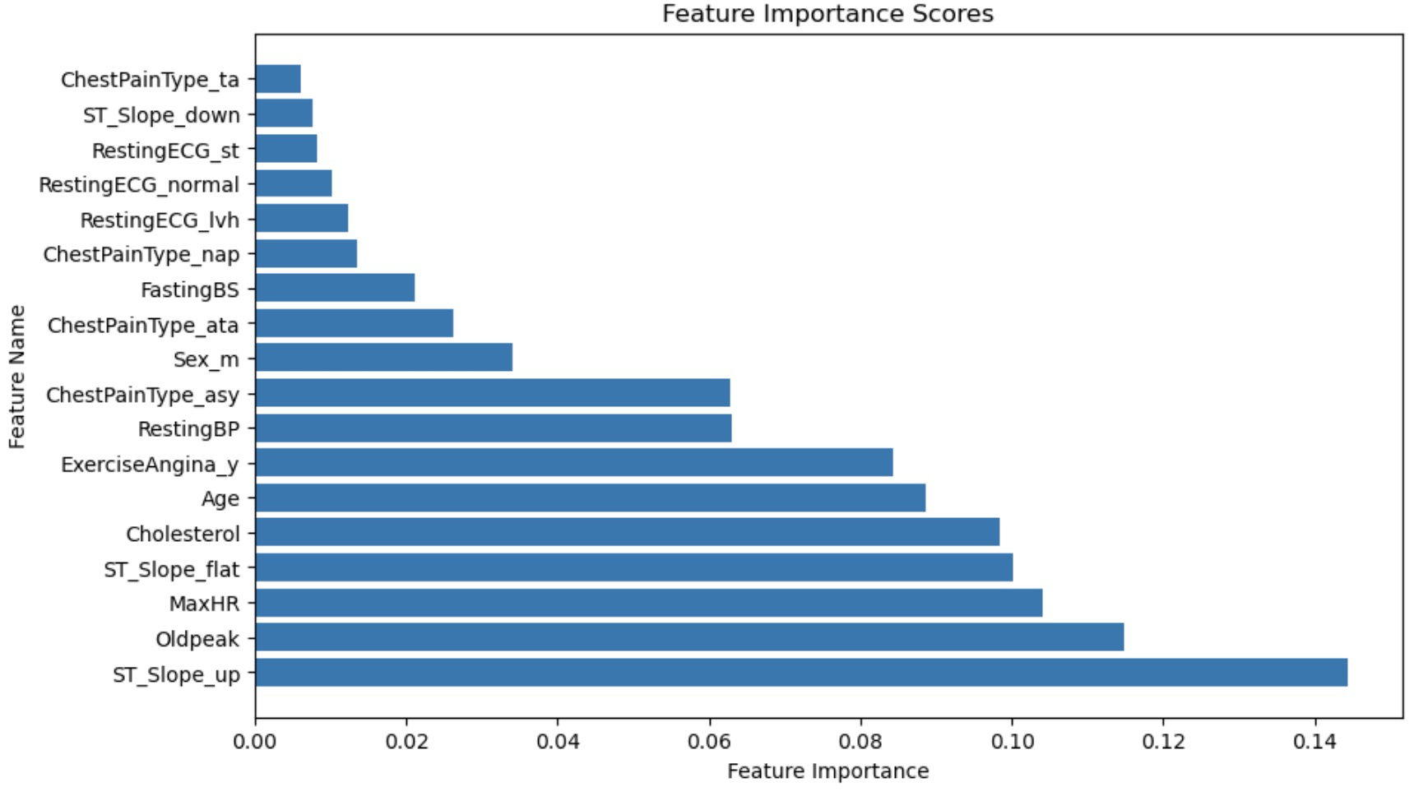
Feature Importance Scores & Optimizing RANDOM FOREST CLASSIFIER Model
feature_importances_
ST_Slope_up: 14.44%
Oldpeak: 11.49%
MaxHR: 10.40%
ST_Slope_flat: 10.01%
Cholesterol: 9.84%
Age: 8.86%
ExerciseAngina_y: 8.43%
RestingBP: 6.30%
ChestPainType_asy: 6.28%
Sex_m: 3.39%
ChestPainType_ata: 2.63%
FastingBS: 2.12%
ChestPainType_nap: 1.36%
RestingECG_lvh: 1.23%
RestingECG_normal: 1.03%
RestingECG_st: 0.82%
ST_Slope_down: 0.77%
ChestPainType_ta: 0.61%
Notes:
SPEAKER // MIKE //
After selecting RANDOM FOREST as our Model to Optimize. We could then take a closer look into the Feature Important Scores.
Each feature is assigned a percentage that reflects its contribution to the overall predictive performance of the model.
The higher the percentage, the more influential the feature is in making predictions.
The feature importance scores indicate the influence of each feature on the model's decision. The top features with higher percentages suggest stronger relationships with the target variable (HeartDisease).
In the top 3 we see:
ST_Slope_up: 14.44% // There is a significant relationship between the upward slope of the ST segment and the likelihood of heart disease.
Oldpeak: 11.49% // The magnitude of the exercise-induced ST depression relates strongly to the presence of heart disease.
MaxHR: 10.40% // Maximum heart rate achieved during exercise is a key factor in predicting heart disease.
And then we see “ST_Slope_flat” and “Cholesterol” as good indicators as well.
ST_Slope_flat: 10.01% // A flat slope of the ST segment is associated with a considerable impact on heart disease predictions.
Cholesterol: 9.84% // Serum cholesterol levels contribute significantly to the model's understanding of heart disease likelihood.
[ Next Slide ]

Slide 20
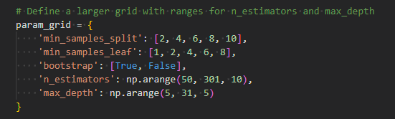
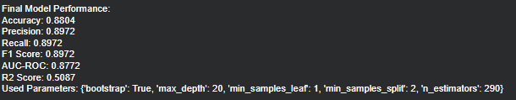
Model Optimization using Random Forest Classifier
Identifying the best model parameters for predicting heart disease around 39000 fits
Figure 20.1 Parameter ranges that we used for testing
Figure 20.2 This python output is the Final Model Performance after running a GridSearch for the most optimal model parameters. 5 different parameters

Slide 21
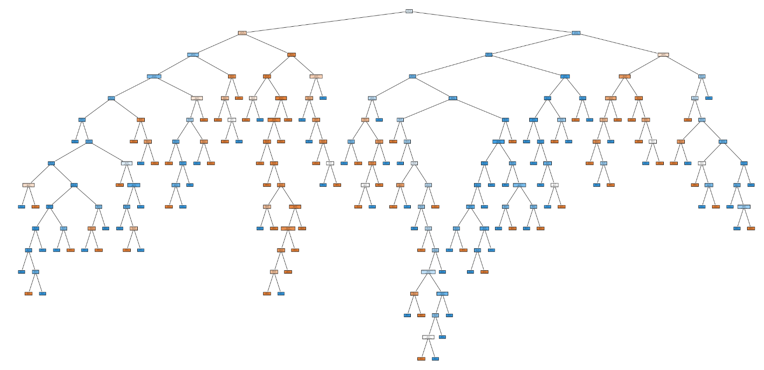
Tree Decision Diagram of our Data Model

Slide 22
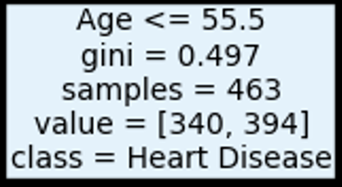
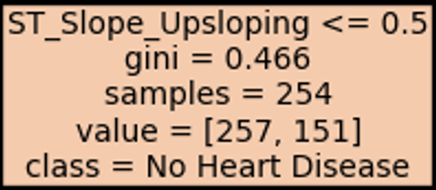
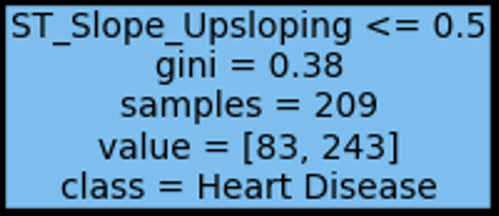
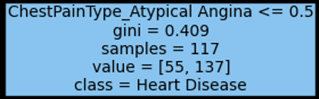
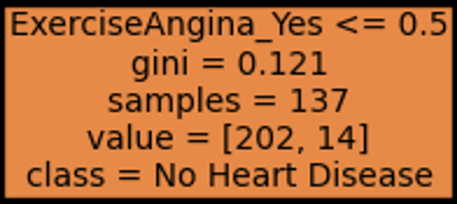
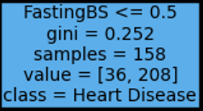

Tree Decision Diagram of our Data Model
Notes:
The top most condition or node starts with the age 55 or less. Given the decision tree, age is one of the important conditions then next is ST_Slope_Upsloping then Chest Pain Type Asymptomatic

Slide 23

Notes:
After finalizing on the Random Forest Classifier as our main model and training our model with our SQLite3 database, we were able to create a simple web app that would take input values on our 11 trained features and provided a predictive output as to whether or not you are at risk of heart disease.
I’ve got two instances of the model open, one with healthy prediction results, and one with the risk of heart disease.
For those with the risk of heart disease you will also get a list of key factors contributing to heart disease, with a suggestion on the range you would want your input to be, along with healthy lifestyle choices you can make and possible medication you can take to lessen your risk of heart disease.

Slide 24
Q & A
Thanks for listening :)

